Slide 1



Slide 2
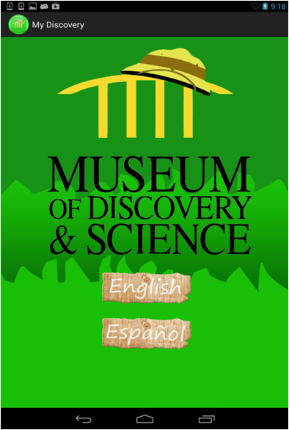
My Discovery “Interactive MODS Tour Guide”

Slide 3
Purpose
Many people visit museums unknowing of the treasures they hold, My Discovery hopes to change that for the Museum of Discovery and Science.
Users of the app will no longer have trouble finding places to park, or deal with overpaying for parking.
Users will know what is in the museum, what interests them most, where they want to go and what activities they can take part in, without having to search for a museum directory, or paper map.
The game, Manatee Mania also brings awareness to an issue presented in the “Living in the Everglades” exhibit, and advertises the exhibit.

Slide 4
Goals
“Museum in your pocket”
All ages
Parents can be teachers
Navigation help
Easy to use
Tailor make your own experience

Slide 5
Versatility
Our app features aspects that appeal to almost all demographics.
It is offered in English and Spanish (which are among the most spoken in Florida).
In addition to an interactive museum map with exhibit information, it includes a game to play to entertain its users and address an environmental problem, as well as an interactive parking map that displays the rates and locations.

Slide 6
TEFFO: the basis of principles on which My Discovery was built upon
T-Theme, we wanted to build our app around a specified theme, an explorer theme. People come to museums to explore their exhibits while expanding their knowledge.
E-Ease, if the app is not easy to use, it is not helping anyone, simple user interface is vital.
F-Functionality, the app must be versatile and provide a range of different features to suit our users’ needs
F-For Everyone, by appealing to most, if not all demographics, the app can be enjoyed by everyone who uses it
0-Originality, the app had to differentiate itself from other apps, which almost always share the same yellow on black theme and identical information.

Slide 7
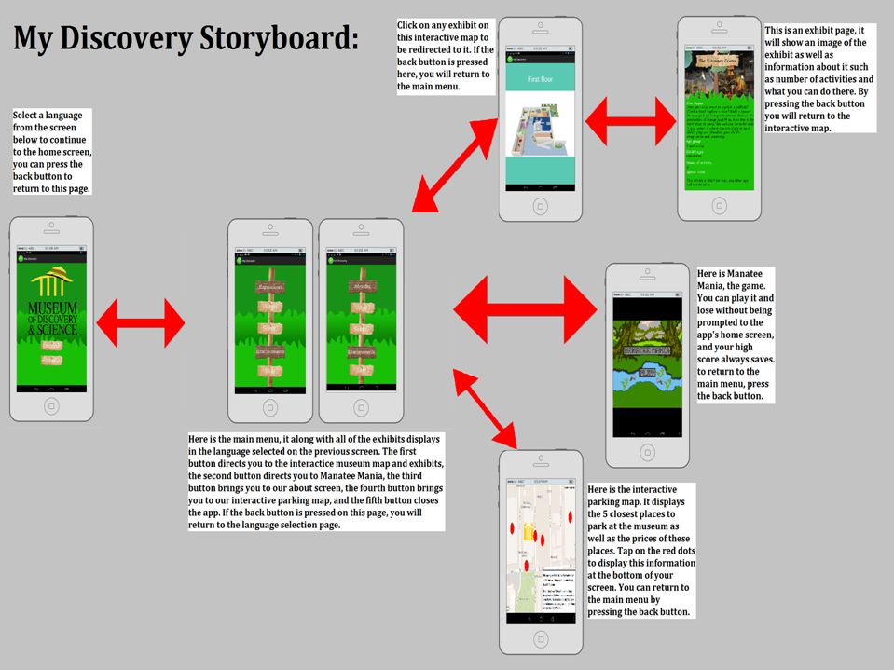

Slide 8
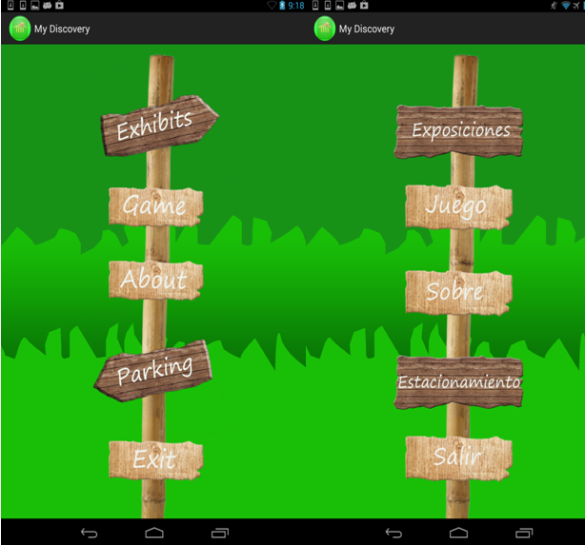
Home Screens

Slide 9
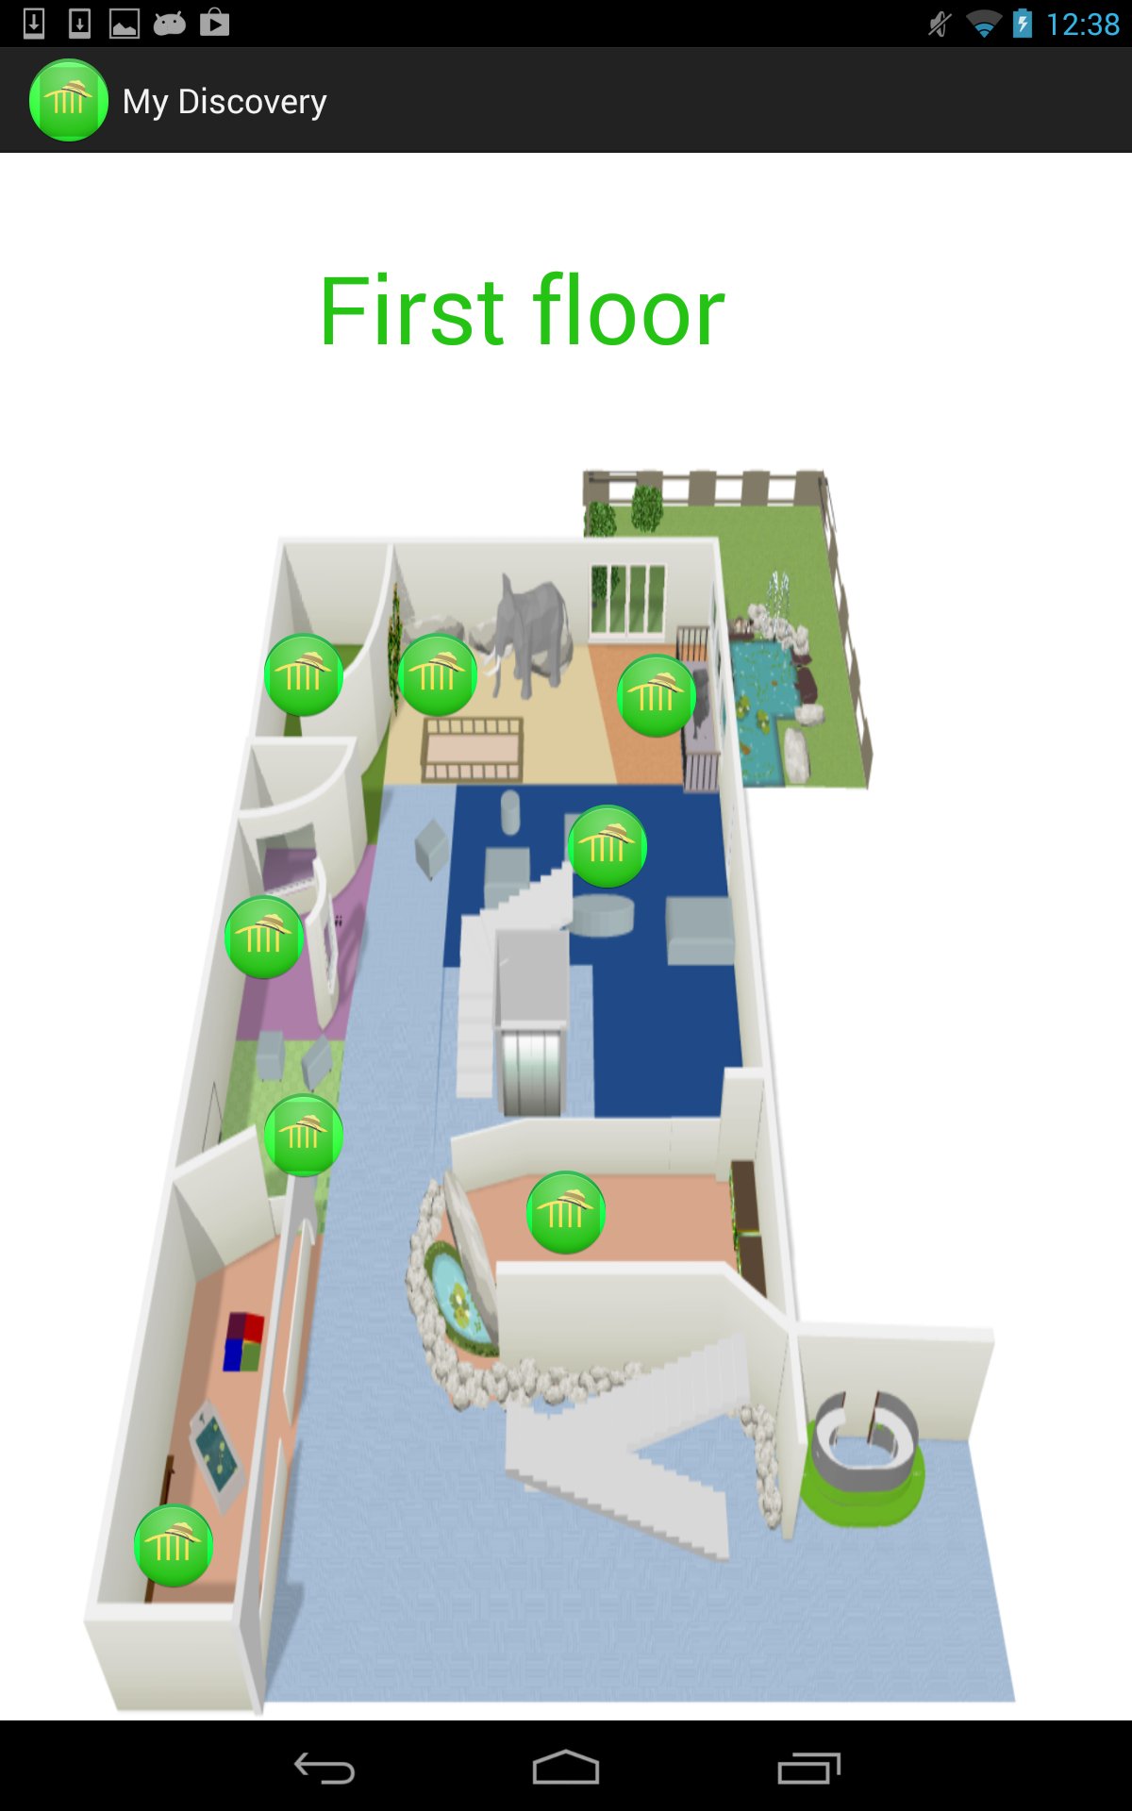
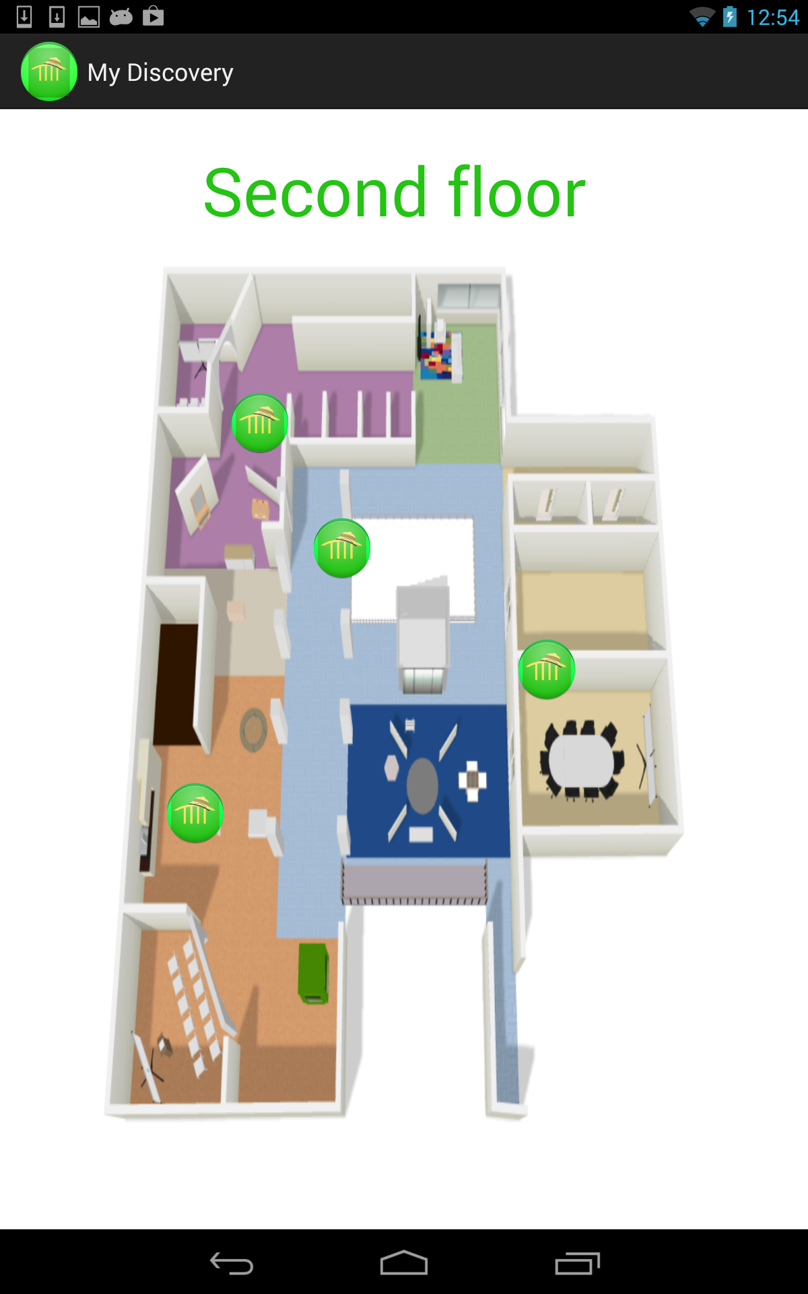
Museum Map

Slide 10
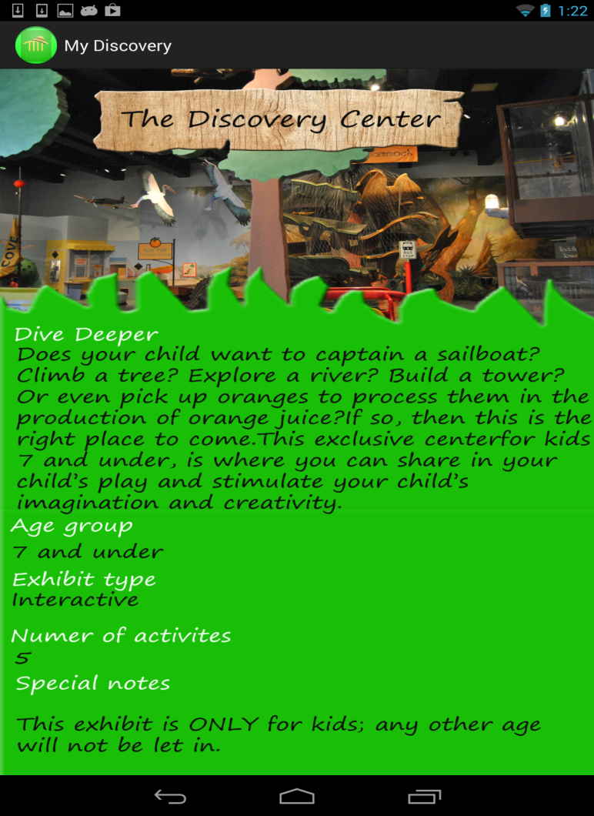
Exhibits
Each exhibit screen can be prompted to by tapping on its location on our interactive museum map.
This screen will include various data regarding the exhibit including images, appropriate age groups, the exhibit type, number of activities, special notes, as well as just enough information to lure the user into visiting it.

Slide 11
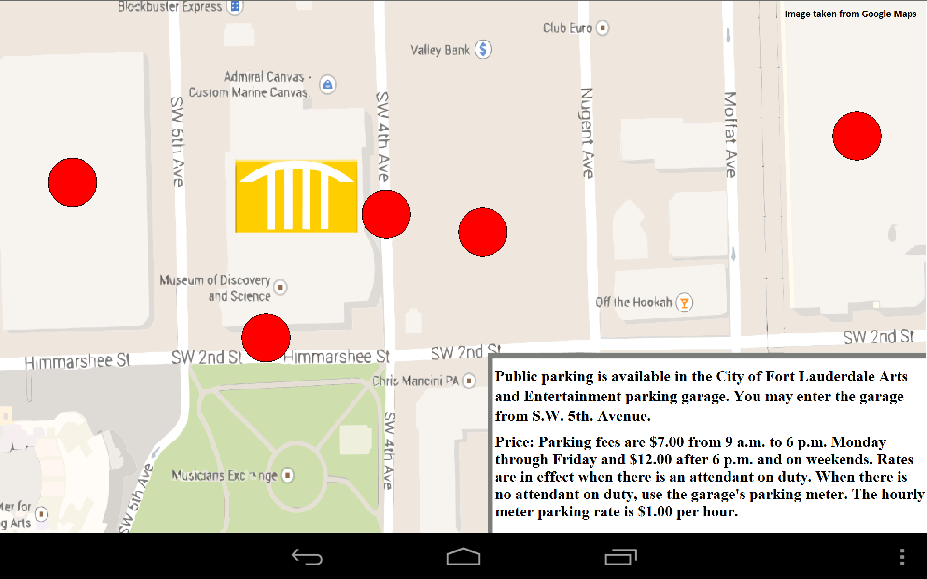
Interactive Parking Map

Slide 12
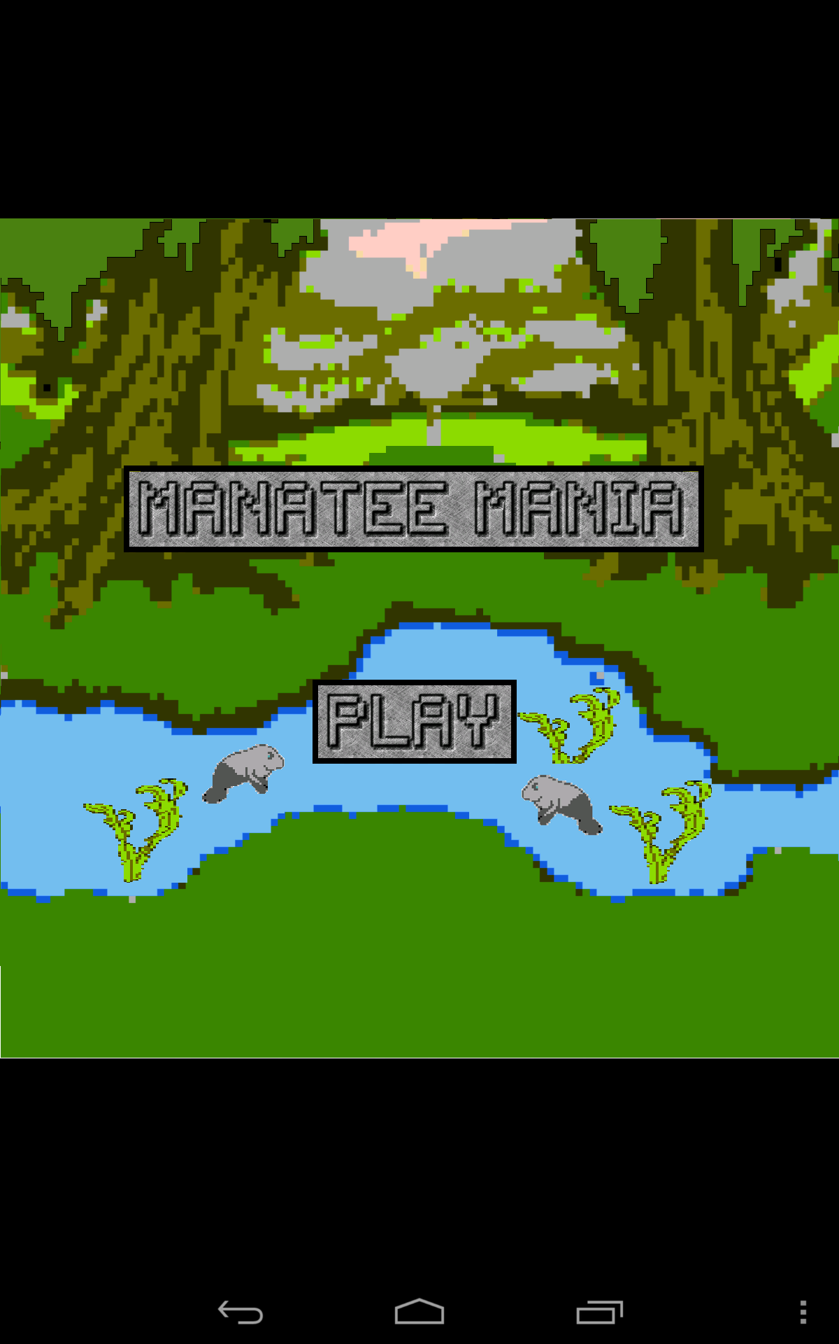
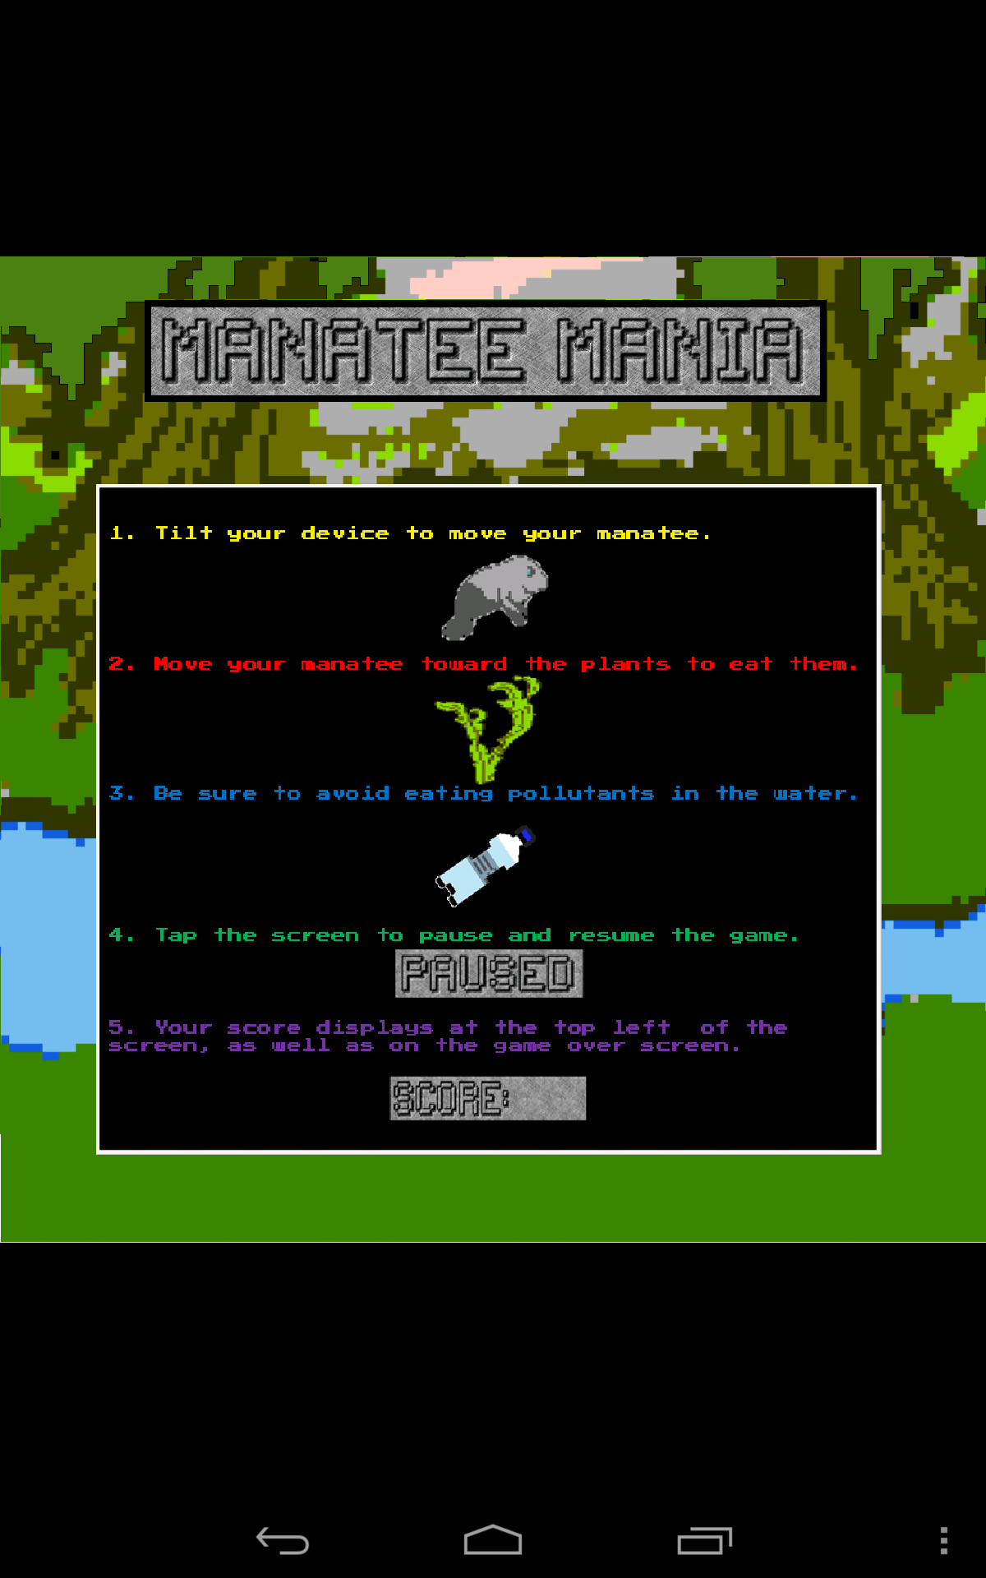
Manatee Mania

Slide 13
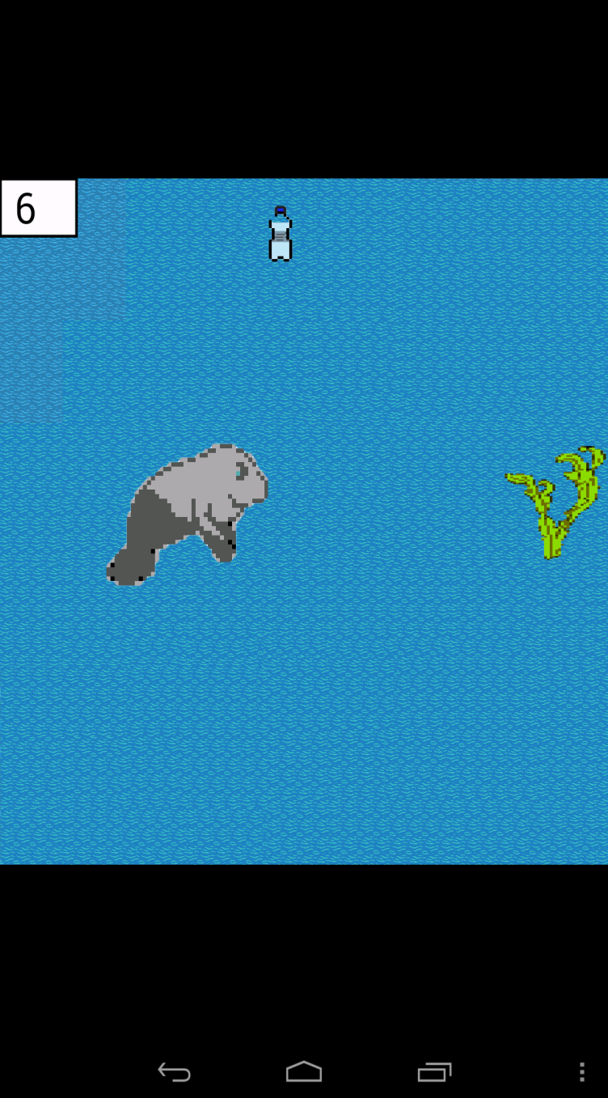
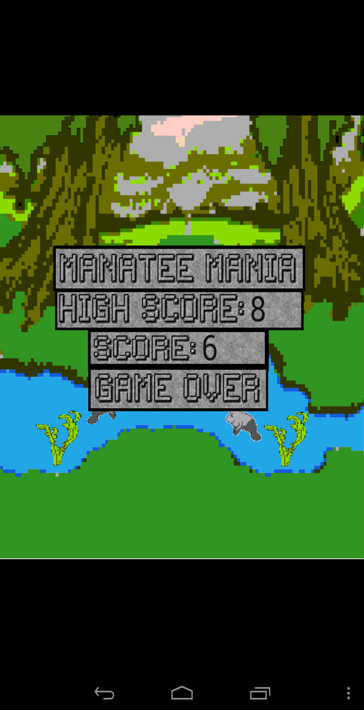
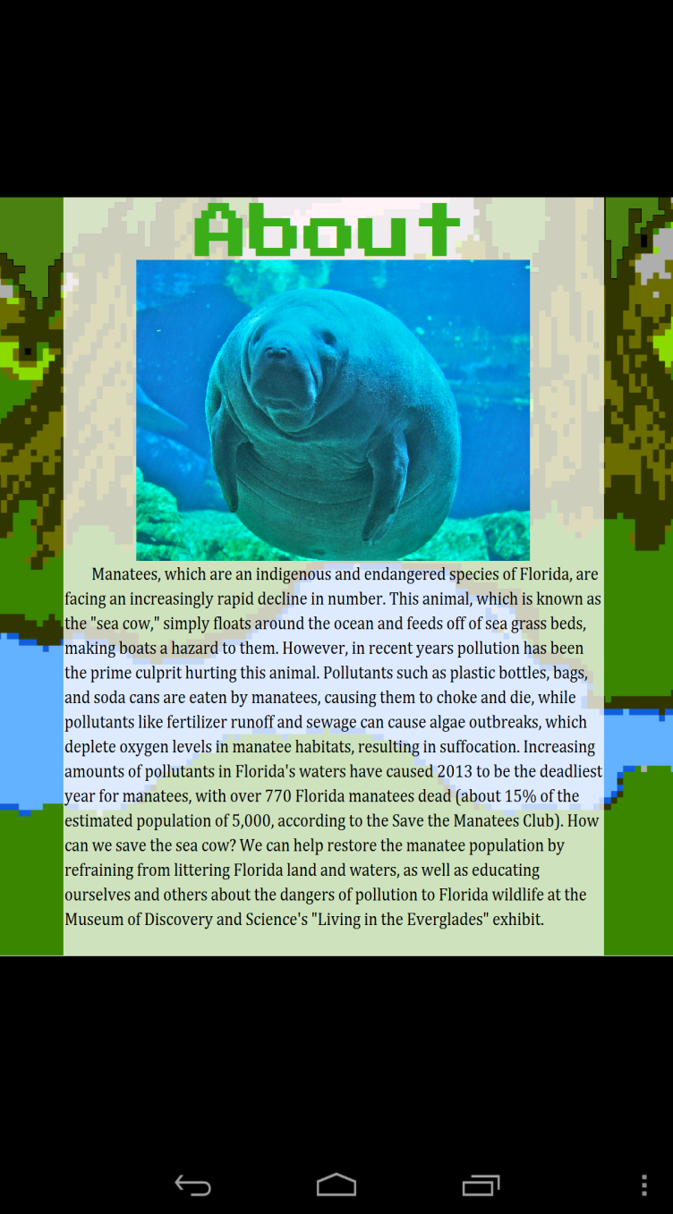
Manatee Mania cont.

Slide 14

Marketing Video

Slide 15




Questions? Concerns?
Feel free to inquire about any aspect of this app
Would anyone like to test the My Discovery app or play ?

